Slide 1

Tripple 7 Movie Empire
Review
By Group 7
AVERY DAVIS

Slide 2

Tripple 7
Business Understanding
Business Problem
Tripple 7 wants to enter the movie industry
It lacks knowledge of what makes movies successful
This is a high risk of financial loss without data insights
Why this matters:
Poor investment decisions could lead to major losses

Slide 3
Tripple 7
Project Objectives and Questions
Objectives
Questions
To determine the movie genres that are the most profitable.
To determine the best time to release a movie for maximum returns.
To determine whether higher-rated movies generate more revenue.
Which movie genres are the most profitable?
When is the best time to release a movie for maximum returns?
Do higher-rated movies generate more revenue?.

Slide 4
Tripple 7
Data Sources
We agreed to use two key datasets as they were the most relevant to answering our research questions:
TMDb dataset (tmdb.movies.csv)
as it Provides movie details (genres, ratings, popularity)
The Numbers dataset (tn.movie_budgets.csv)
as it Provides financial data (budget, revenue)

Slide 5

Tripple 7
Data Understanding
2316 movies
Key variables:
Genre
Budget
Domestic & worldwide revenue
Ratings

Slide 6
Tripple 7
Data Understanding
What we did:
Why we did this:
Merged TMDb + The Numbers datasets
Joined using:
original_title (TMDb) and movie (The Numbers)
Result:
Final dataset: 2316 movies
TMDb gives ratings & genres
The Numbers gives financial performance
Combining them allows us to answer our research questions.

Slide 7
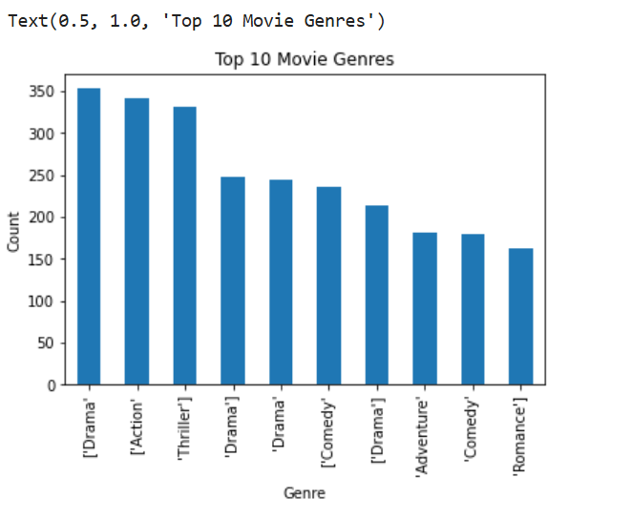

Tripple 7
Data Understanding
Top 10 Movie Genres
After analysis of the top 10 movie genres, the top most movie genre was drama, and the last was Romance.

Slide 8
Tripple 7
Data Preparation
Data Cleaning & Preparation
Feature Engineering
Converted revenue columns from text to numeric
Checked for missing values, where none was found
Removed duplicates
Created:
total_profit = worldwide_gross -production_budget
release_year from date
Genre mapping (IDs → names)

Slide 9
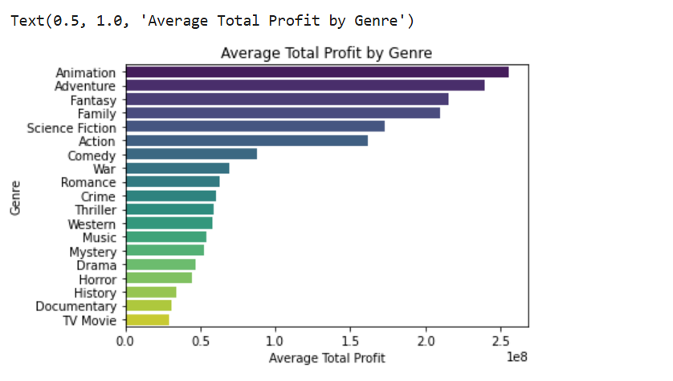
Tripple 7
Analysis
Research Question 1
Which movie genres are most profitable?
Top genres:
Animation
Adventure
Fantasy
Business Insight:
Genre strongly influences profitability
High-performing genres consistently generate higher returns

Slide 10
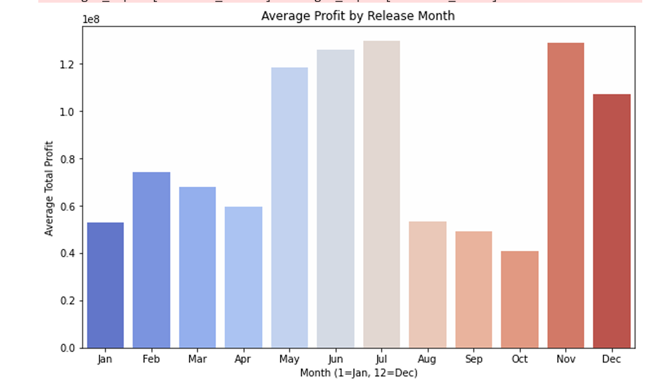
Tripple 7
Analysis
Research Question 2
When is the best time to release movies?
Movies released in summer (May–July) generate the highest profits
Secondary peak occurs in holiday season (Nov–Dec)
These periods align with:
School holidays
Increased leisure time
Higher audience turnout
Business Insight:
Releasing movies during peak seasons maximizes box office revenue and audience reach

Slide 11
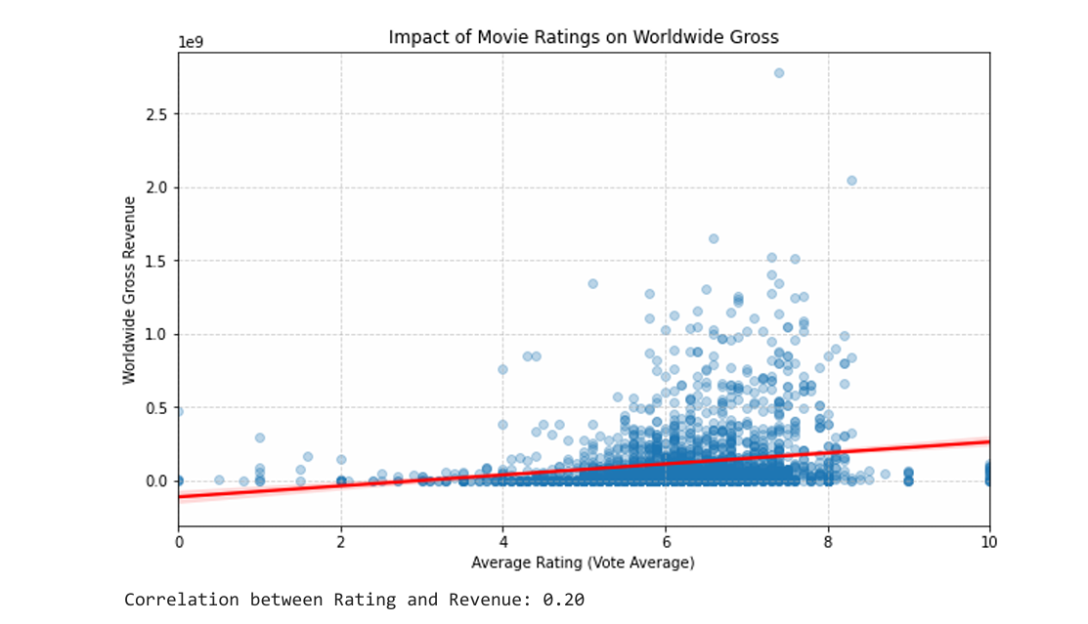
Tripple 7
Analysis
Research Question 3
Do higher-rated movies generate more revenue?
RESULTS:
Weak correlation between ratings and total profit (0.20)
Highly rated movies do NOT always generate high revenue
Other factors (genre, release timing, marketing) have stronger impact
Business Insight:
High ratings alone do not guarantee success. Hence, focus on strategy, not just quality

Slide 12
Tripple 7
key Insights
Genre is the strongest driver of profitability
Animation, Adventure, Fantasy dominate revenue
Release timing significantly impacts success
Ratings have minimal influence on revenue
Industry growth driven by technology and streaming trends

Slide 13
Tripple 7
Recommendations
Invest in high-performing
genres: Animation, Adventure, Fantasy,
2. Schedule releases during:
Summer (May–July), Holiday season (Nov–Dec)
3. Focus on:
Strong marketing campaigns, Audience targeting strategies, High production quality.
4. Avoid relying solely on ratings as a success metric

Slide 14
Tripple 7
Conclusion
Data analysis provides clear guidance for Tripple 7 to enter the movie industry.
Success depends on:
Choosing the right genre, Timing releases strategically, Understanding audience behavior
By applying these insights, Tripple 7 can:
Reduce financial risk, Increase profitability, Make data-driven decisions.

